Slide 1
How to use git in Eclipse

Slide 2
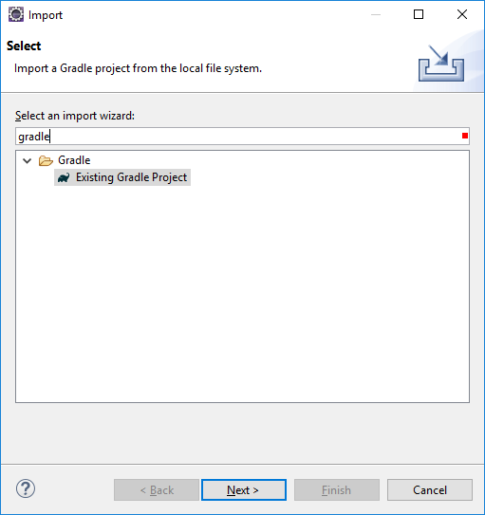
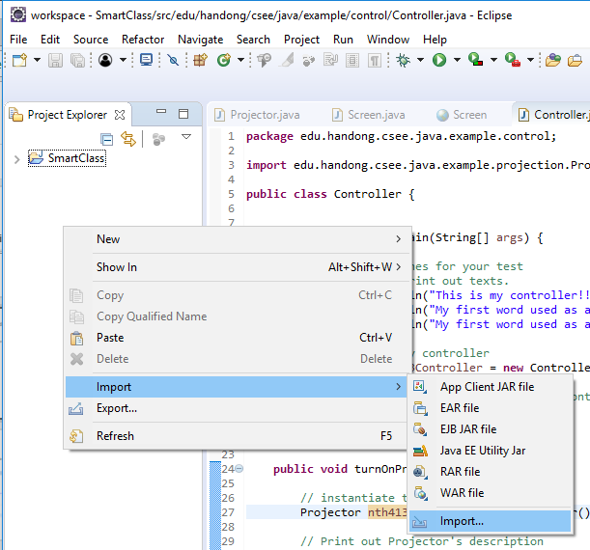
Import gradle Java project in Eclipse
Import gradle project into Eclipse
Pop-up menu on Package Explorer → Import → Import → Search 'gradle' → Gradle/Existing Gradle Project

Slide 3
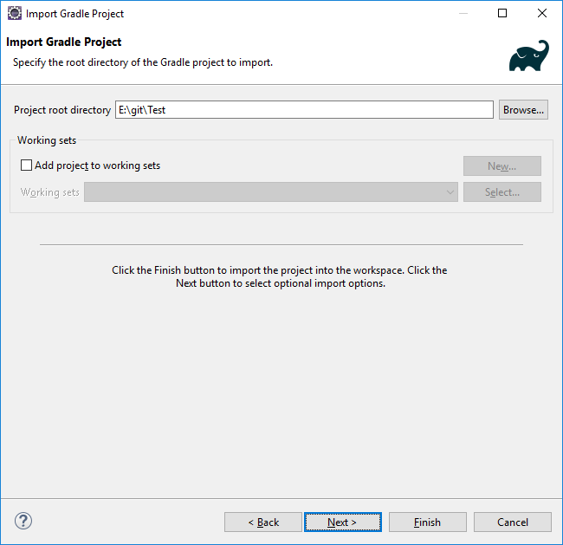
Import gradle Java project in Eclipse (2)
Import gradle project into Eclipse
Select Gradle/Existing Gradle Project → Next → Next → Browser your gradle java directory → Next → Next → Finish

Slide 4
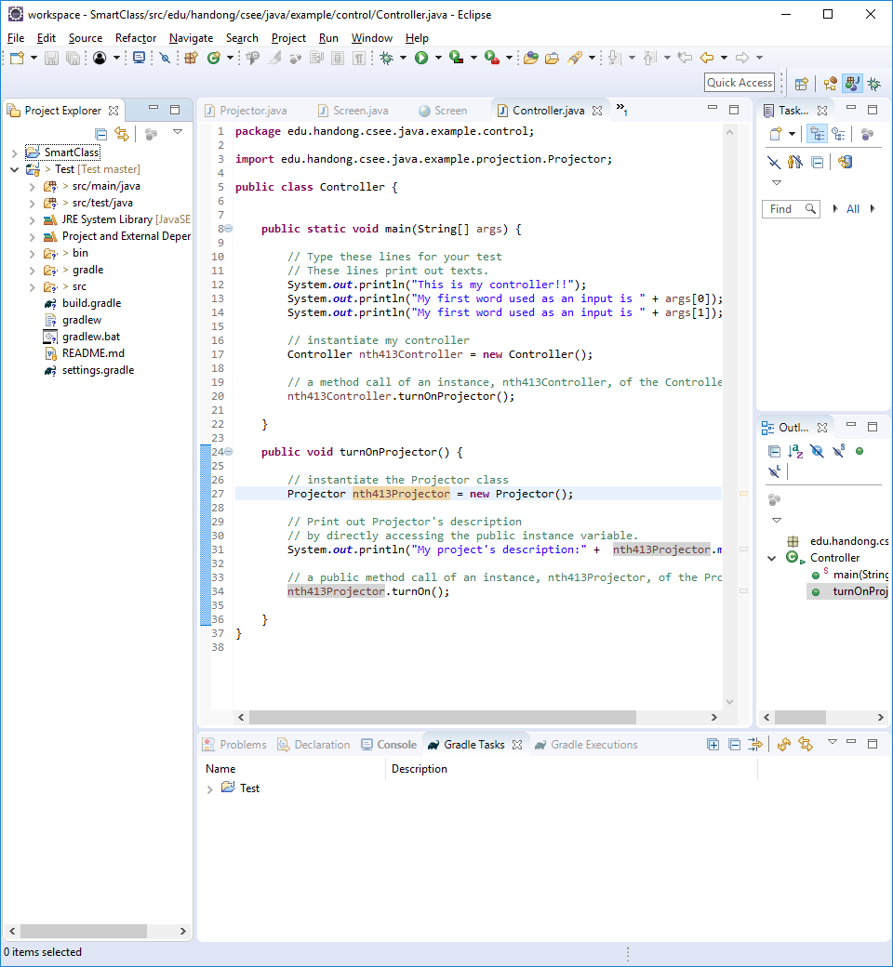
Import gradle Java project in Eclipse (3)
The gradle java project is now in Package Explorer in Eclipse

Slide 5
Meaning of Icons for git status in Package Explorer
?
Files or folders are in my git DIRECTORY but not in my git REPOSITORY.
Files or folders are in my git REPOSITORY.
>
Any changes in files or folders are not saved into my git REPOSITORY.

Slide 6
Meaning of icons in Package Explorer
?
Files or folders are in my git directory but not in my git repository
We first register the files or folders before committing them in git repository. (Staging or Add to index)
>
files or folders are in my git repository but any changes in them are not save into my git repository
The indexed files of folders need to be saved (committed) into a git repository. (git commit)
Files or folders are in my git repository
Nothing to do
as they are already in my git repository.

Slide 7
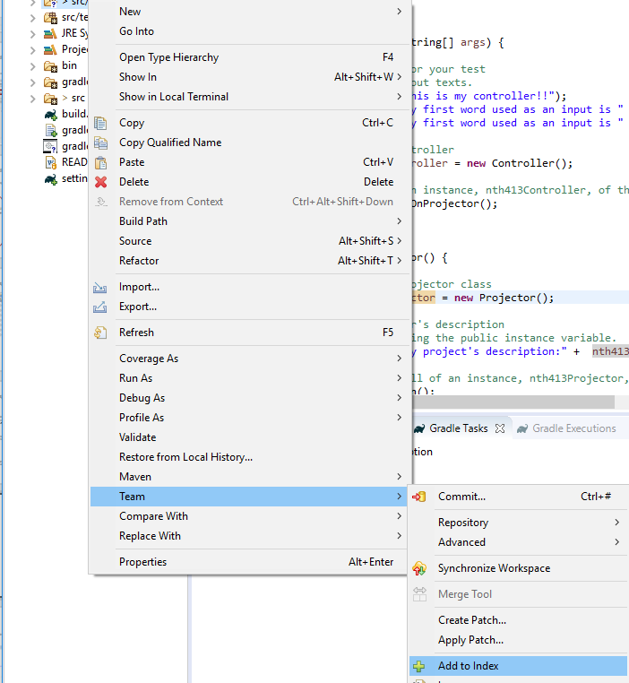
Add to Index
?: Popup menu on files or directories with ? → Team → Add to Index
Do not add the bin directory where all bytecode files exist. You only commit source code.
Add only these

Slide 8
Other Icons
*
There are some files under this directory that are added to index but not committed yet.
+
A files is added to index.
Meaning of all icons
http://wiki.eclipse.org/EGit/User_Guide/State#Label_Decorations

Slide 9

Commit Vs. Push
PC
File
Local repository
Remote repository
File
Commit
Push

Slide 10
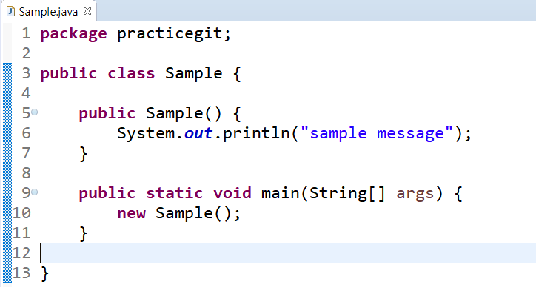
Commit
Assume that you have your source code in Eclipse. As an example, we have the Sample class file.
ex)

Slide 11
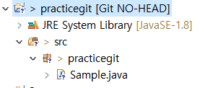


Commit
2.Right click on your project->[Team] ->[Add to index] and then [Team] -> [Commit]
This symbol must be changed to after ‘commit’ is completed.

Slide 12
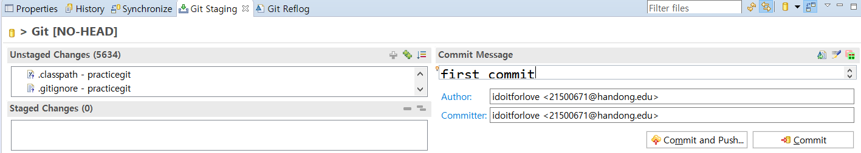
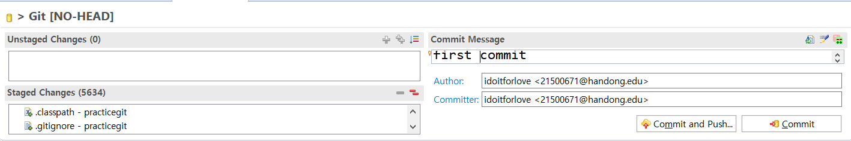
Commit: commit and push , commit
3.Staging and Commit
* Always add .gitignore if they are not added.
staging (If you didn’t run the ‘add to index’ command in the previous step..)
You must enter commit message. You can check your commit message in your remote repository in Github.

Slide 13
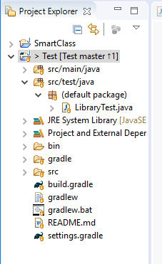
After commit
Repository name in Github
[Test Master ↑1] : There is one commit that did not push yet
into Master branch in the Test repository in Github.
Branch name in the Github repository

Slide 14
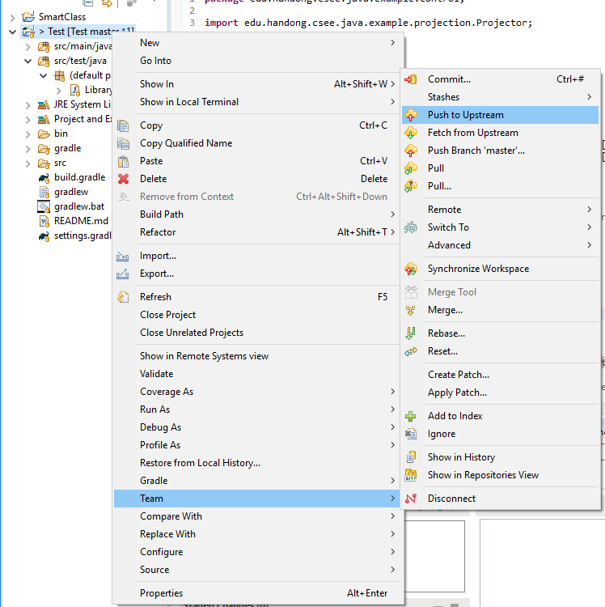
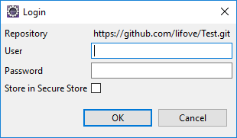
Push
Push: Upload my change in the remote git repository in Github!!!
Pop-up menu on the project → Team → Push to Upstream → Login to github in Eclipse

Slide 15
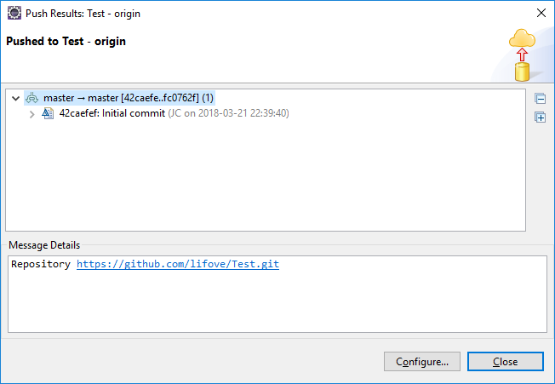
Push Result

Slide 16
Commit: commit and push , commit
We may commit and push at the same time.
staging (If you didn’t run the ‘add to index’ command in the previous step..)
You must enter commit message. You can check your commit message in your remote repository.

Slide 17
Pull
Get updated source from my colleague

Slide 18

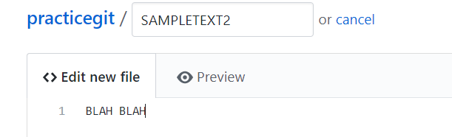
Pull
Create a new file in your remote repository. (Creating a new file is just demonstrating one of your colleague is updated the repository. This is only for testing 'pull' for your exercise.)
Enter “blah blah..” and Commit the file.

Slide 19
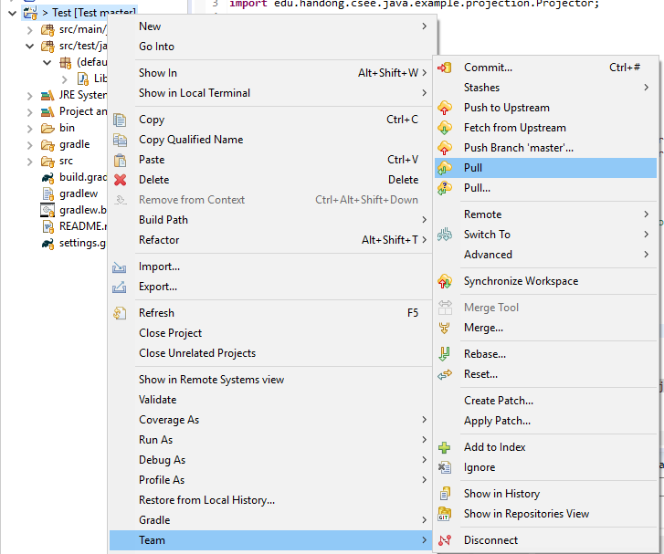
Pull in Eclipse
Popup on a project → Team → Pull

Slide 20
Pull test
Create a new file in a remote git repository of your Github

Slide 21
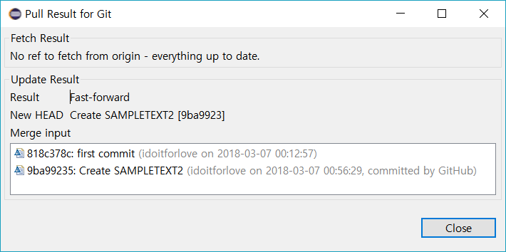
Pull

